Slide 1
Free Fall

Slide 2
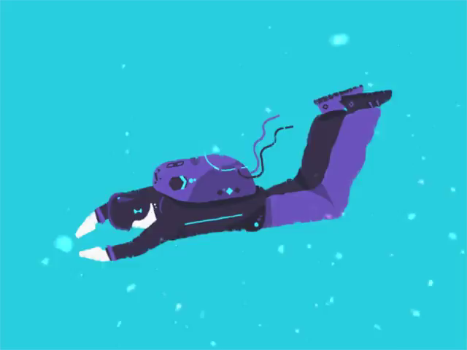
In this Smart lesson you will learn to:
Recall that acceleration due to gravity is constant near the Earth's surface.
Distinguish between mass and weight.
Solve gravitational problems using the kinematic equations.

Slide 3
Gravity (also known as gravitational force) is a non-contact force that acts on everything on Earth.
Gravity is an attraction between two masses. It pulls objects together. You don't even need to be standing on the surface of the Earth for it to affect you!

Slide 4
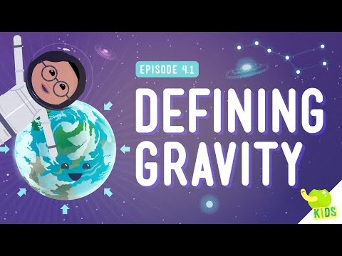

Slide 5
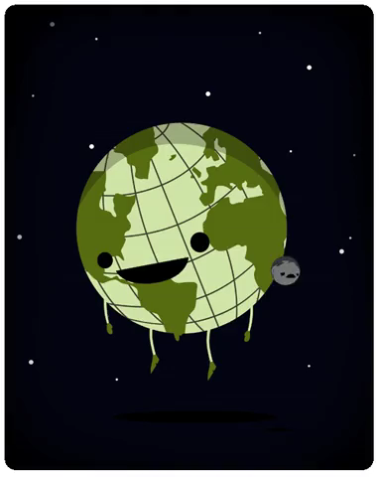
Gravitational force is responsible for many things that happen in our universe.
The Moon is kept in orbit because the Earth exerts a gravitational force on it. As the Moon moves, the Earth continually pulls on it. The Moon does not crash into the Earth because it is moving at a certain speed, which is just fast enough to keep it moving around the Earth in an orbit.

Slide 6
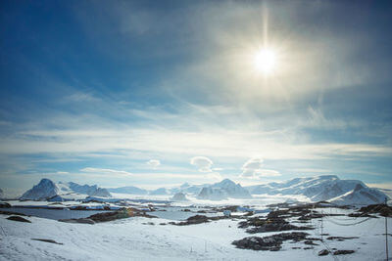
Gravity is only noticeable for really big masses, such as the Earth.
The Earth's gravity holds everything close to the Earth, like all the people, trees and buildings.
Gravity on Earth pulls things towards the centre of the Earth. This is why you can walk on the south pole, on the very bottom of the Earth, and not fall off!

Slide 7
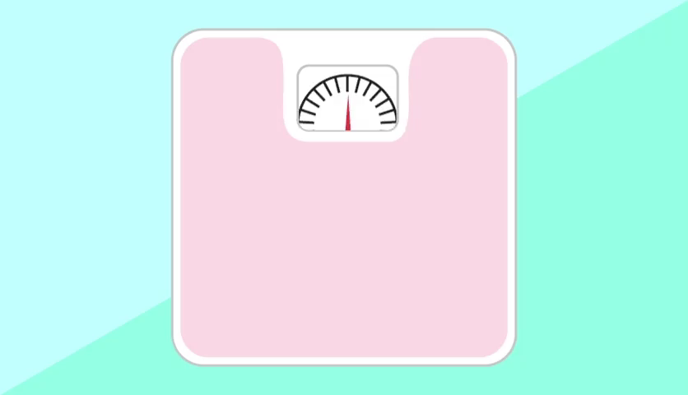
What is the difference between mass and weight?
In everyday life, the terms mass and weight are interchangeable. However, in physics they have special meanings.
Mass is the amount of matter in an object, measured in kilograms (kg). Your mass is the same (constant) wherever you are, even if you go to a different planet!

Slide 8
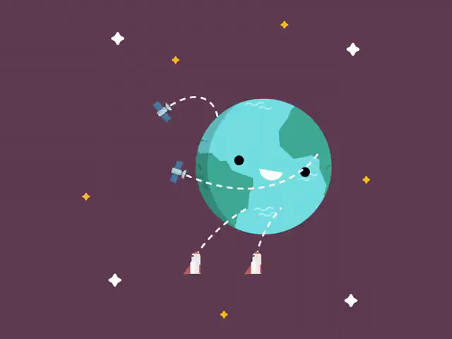
Weight is the force acting on an object due to gravity.
It is the gravitational force between an object and the planet it is sitting on.
It is a way of measuring the effect of gravity on objects on the surface of a planet.
Weight is measured in Newtons, just like every other force.

Slide 9
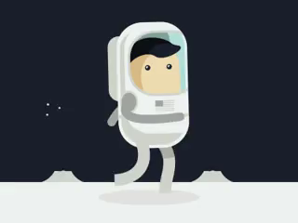
How does mass affect weight?
Your weight changes on planets with different gravity to Earth, however your mass is always the same, no matter where you are!
Two objects with different masses will have a different weight force on Earth.
An object with a greater mass will have a stronger weight force than an object with a smaller mass.

Slide 10
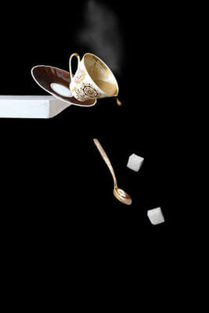
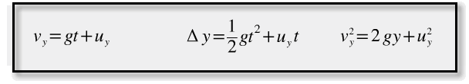
Gravitation allows us to examine what happens to an Earth-bound object when it's falling.
In freefall, the only force acting on an object is gravity, which always acts straight down relative to the ground. Usually we can ignore other forces like air resistance. This gives any falling object a constant downward acceleration of 9.8 ms−2.
Constant acceleration means you can use the kinematic equations in gravitation problems. Look at the following equations. Can you spot any similarities between them and the kinematic equations?

Slide 11
These are 3 of the kinematic equations but using some different letters.
The three kinematic equations relate the displacement, velocity and acceleration of an object.
When we use them to solve freefall problems, the acceleration is equal to g. Therefore g and a are inter-changeable in these formulae. We use t for time, which should always be measured in seconds.
The letter y stands for vertical displacement. In freefall problems, we ignore air resistance and wind, so all the motion is vertical.

Slide 12

Finally, uy​ and vy​ both represent velocity. We use u to represent the initial velocity of an object, when it begins to fall. It is usually just 0. The letter v is the final velocity, how fast the object is moving at the end of the time frame we're interested in. The subscript y is to remind us that the motion is in the vertical direction.
Can you see how they relate to the general kinematic equations?

Slide 13
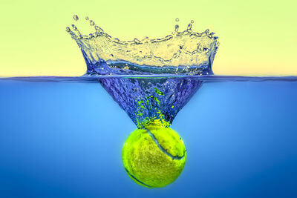
Using kinematic equations in free fall problems.
Let's have a look at how these equations are used in free fall problems. They may look scary at first, but with some practice, they will become like friends to you!

Slide 14
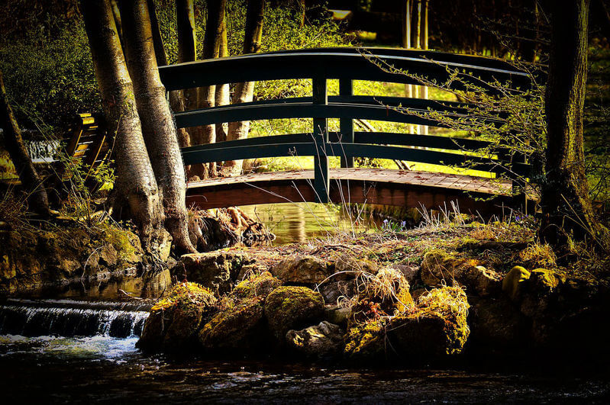
Christopher Robin and Pooh bear are playing Pooh sticks.
This is a game where you both drop a stick from a bridge into the water below and see which one passes under the bridge the fastest.
It takes exactly 1s for the stick to reach the water.
Assuming g=9.8m/s2, calculate how high the bridge is.

Slide 15
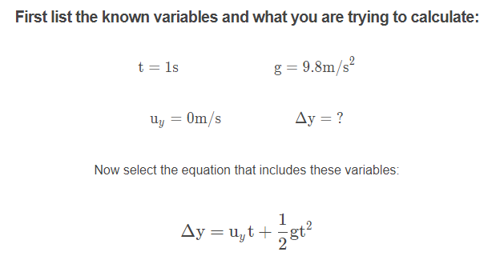

Slide 16
